Slide 1

INCONTINENZA URINARIA: TERAPIE INNOVATIVE
Relatore: Dott. A. Zucchi
Clinica Urologica ed Andrologica
Università degli Studi di Perugia

Slide 2
INCONTINENZA
Pazienti con stomia urinaria
(VESCICA ORTOTOPICA)
Pazienti con stomia fecale
(ESITI DANNO NEUROLOGICO)

Slide 3

POST-PROSTATECTOMY INCONTINENCE
The rate of early UI (3-6 months) varied from 0.8% to 87% and from 5% to 44.5% 1 year after the operation
5-10% of men with PPI are expected to be treated with surgery (Kumar et al, J Urol 2009; Nam et al J Urol 2012)

Slide 4
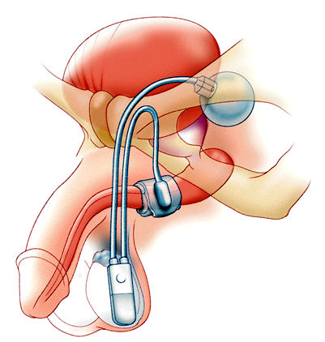
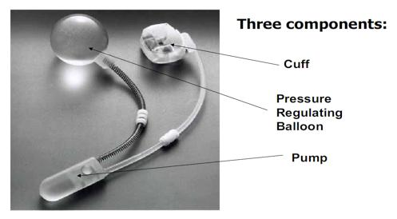
Artificial Urinary Sphyncter
Despite the recent advent of male urethral slings AUS remains the gold standard for treatment of Male stress urinary incontinence, particularly for moderate/heavy severity UI

Slide 5
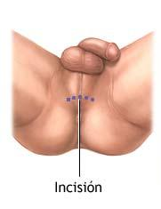
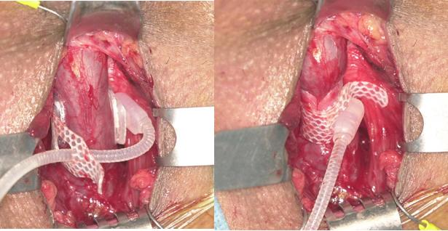

Slide 6
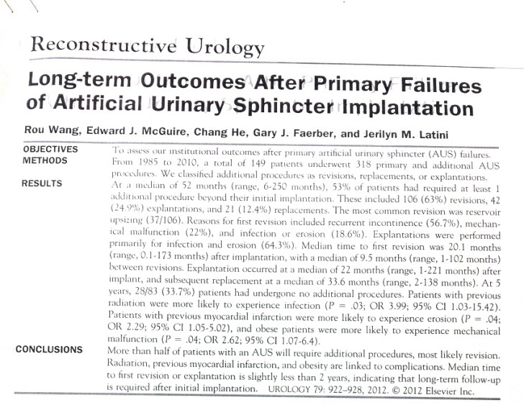
AUS: results
CONTINENCE RATES:
Vary depending on the definition of continence and length of follow-up
Approximately 70% or more can achieve social continence with 0-1 pad
More than 90% of patients are satisfied and would have the device placed again
But:
25% revision rate even in experienced hands
Litwiller, Kim, Fone et al: Post-prostatectomy incontinence and the artifical urinary sphincter: a long term study of patient satisfaction and criteria for success. J Urol 1996;156:1975-80

Slide 7
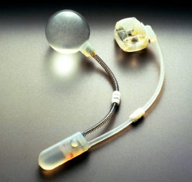

AUS: complications
Infection
Erosion
Recurrent incontinence (different etiology – urethral atrophy)
Mechanical malfunction
  Leaks
  Kinks
  Obstruction in the tubing
  Inability to cycle the device
Patient factors
  Inability to use it
  pain

Slide 8
AUS: risk factors for complications
PATIENTS WITH PREVIOUS RADIATION
  MORE RISK FOR INFECTION AND EROSION
  (mixed results on this topic – controversial recommendation on nocturnal deactivation to prevent subcuff atrophy)
PREVIOUS MYOCARDIAL INFARCTION
  MORE RISK FOR EROSION
OBESE PATIENTS
  MORE RISK FOR MECHANICAL MALFUNCTION

Slide 9
AUS: complications
Wang and McGuire experience 2012
149 patients, median f-up 52 months:
47% primary implantation only – no subsequent procedure
20.8% had 2 procedures
17.4% had 3 procedures
14.4% had 4 or more procedures
Overall patients required a median of 2 procedure
REVISIONS
EXPLANTATIONS
REPLACEMENTS

Slide 10
AUS: explantation and replacement
REASONS FOR EXPLANTATION
INFECTION
EROSION (often of the cuff)
FOLLOWED BY REPLACEMENT IN 50% FOR
RECURRENT INCONTINENCE
TIME TO EXPLANTATION
MEDIAN TIME 22 MONTHS (RANGE 1-221)
TIME TO REPLACEMENT AFTER EXPLANTATION
MEDIAN TIME 33.6 MONTHS (RANGE 2-138)
at least 6 months between procedures for optimal healing

Slide 11
Male slings
FOUR slings
The bone-anchored sling – BASS (Invance sling)
The retrourethral transobturator sling- RTS (AdVance sling)
The adjustable retropubic sling – ARS (Argus system)
Male Trans Obturator Tape (TOT)
Welk and Herschorn 2012

Slide 12
Invance sling
Bone-anchored sling systems (BASS)
  Compresses the urethra with a silicone-coated polypropilene mesh that is fixed to the bony pelvis, avoiding the scarred retropubic space
  Madjar et al using synthetic mesh (2001)
  Cespedes and Jacoby using organic mesh (2001)
Success rate 40-88%
Mesh infection rate 2-12% which usually requires sling explantation (8%)
Our experience with organic mesh
100% failure-rate after 6-12 months for reabsorption of mesh

Slide 13
AdVance sling
Functional retrourethral sling
  Passed “outside-in” through the obturator foramen; the mesh is sutured in place on the ventral surface of the bulbar urethra
Success rate 76-91%
Overall complication rate 23.9%
Low reported explantation rate: only 5 reported cases of removal or revision
Notes:
Questi sono i dati di questo lavoro a 3 aa. 3 centri, 156 pts. About 75% cured (cure defined as wearing no pad or a single safety pad) or improved (improvement defined as wearing one or two pads per day and a reduction in daily pad use of 50%). A total of 109 complications, the vast majority (mainly mild perineal pain) were of low grade, with a single patient requiring reoperation to explant an infected sling during symphysitis

Slide 14
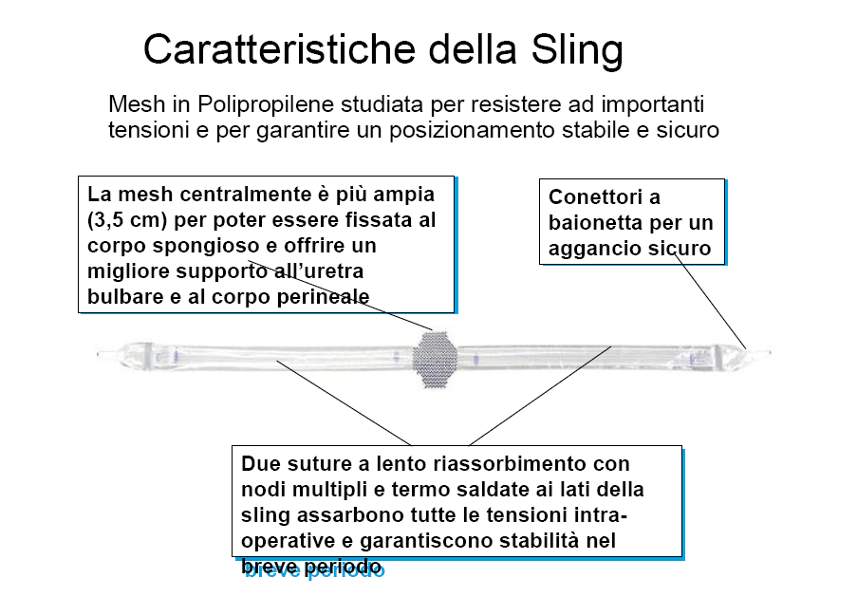

Slide 15
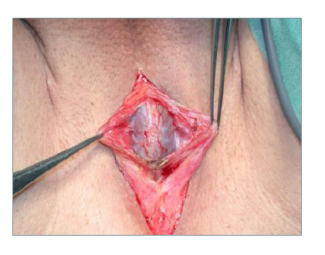

Slide 16
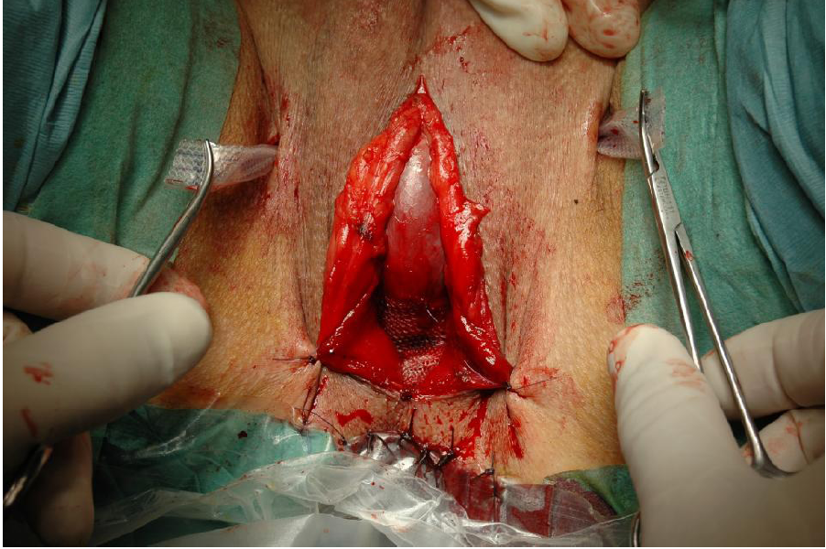
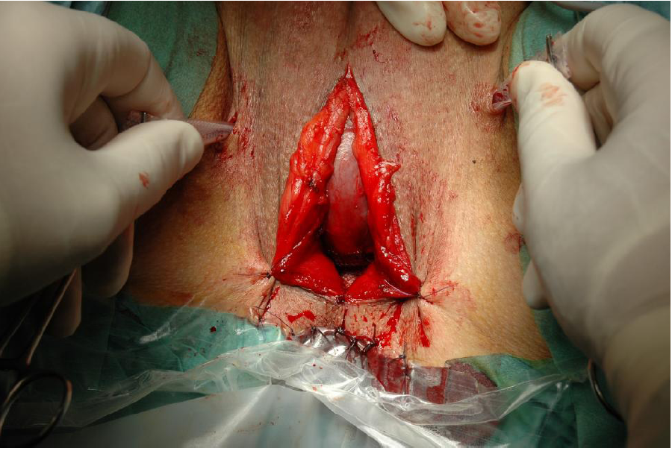

Slide 17
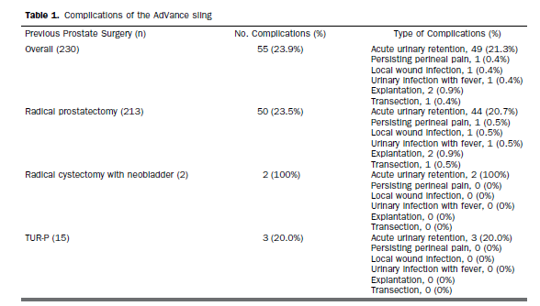
Advance complications

Slide 18
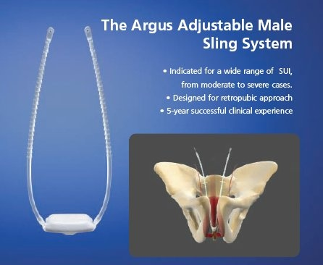
Argus system
The Argus system was first described by Moreno Sierra et al in 2006. The system is composed of a radiopaque cushioned system with silicone foam 42mm x 26mm x 9 mm thick for soft bulbar urethral compression, two silicone columns formed by multiple conical elements, which are attached to the pad and allow system readjustment, and two radiopaque silicone washers which allow regulation of the desired tension
The primary advantage of this design is that the sling tension can be modified through a superficial suprapubic incision

Slide 19
Success rate 72-79%
Erosion 3-13%
Infection 3-11%
Our experience
1 Explanted for unrecognized passage in the bladder
1 Washer eroding through
the abdominal fascia

Slide 20
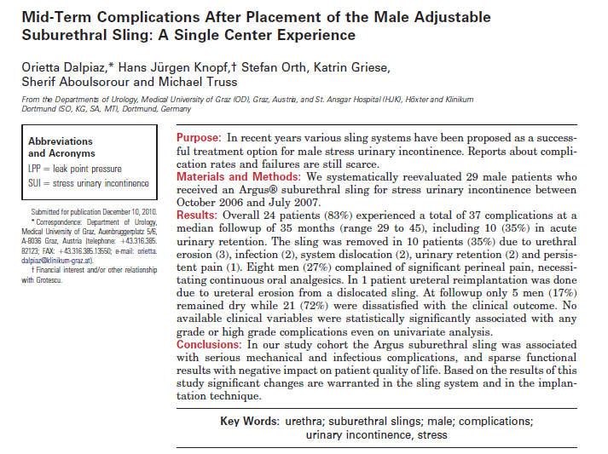
Controversial results !
J Urol 2011

Slide 21
Pro-ACT system
  The ProACT system is an adjustable therapy option; it uses the principle of augmenting titration for optimal urethral coaptation.
  Two balloons are placed bilaterally at the bladder neck. Titanium ports are placed in the scrotum for volume adjustment.
  Postoperative readjustment is very simple, and only local anaesthesia is necessary.
Success rate 70-92%
Complication rate 13.6-36%

Slide 22
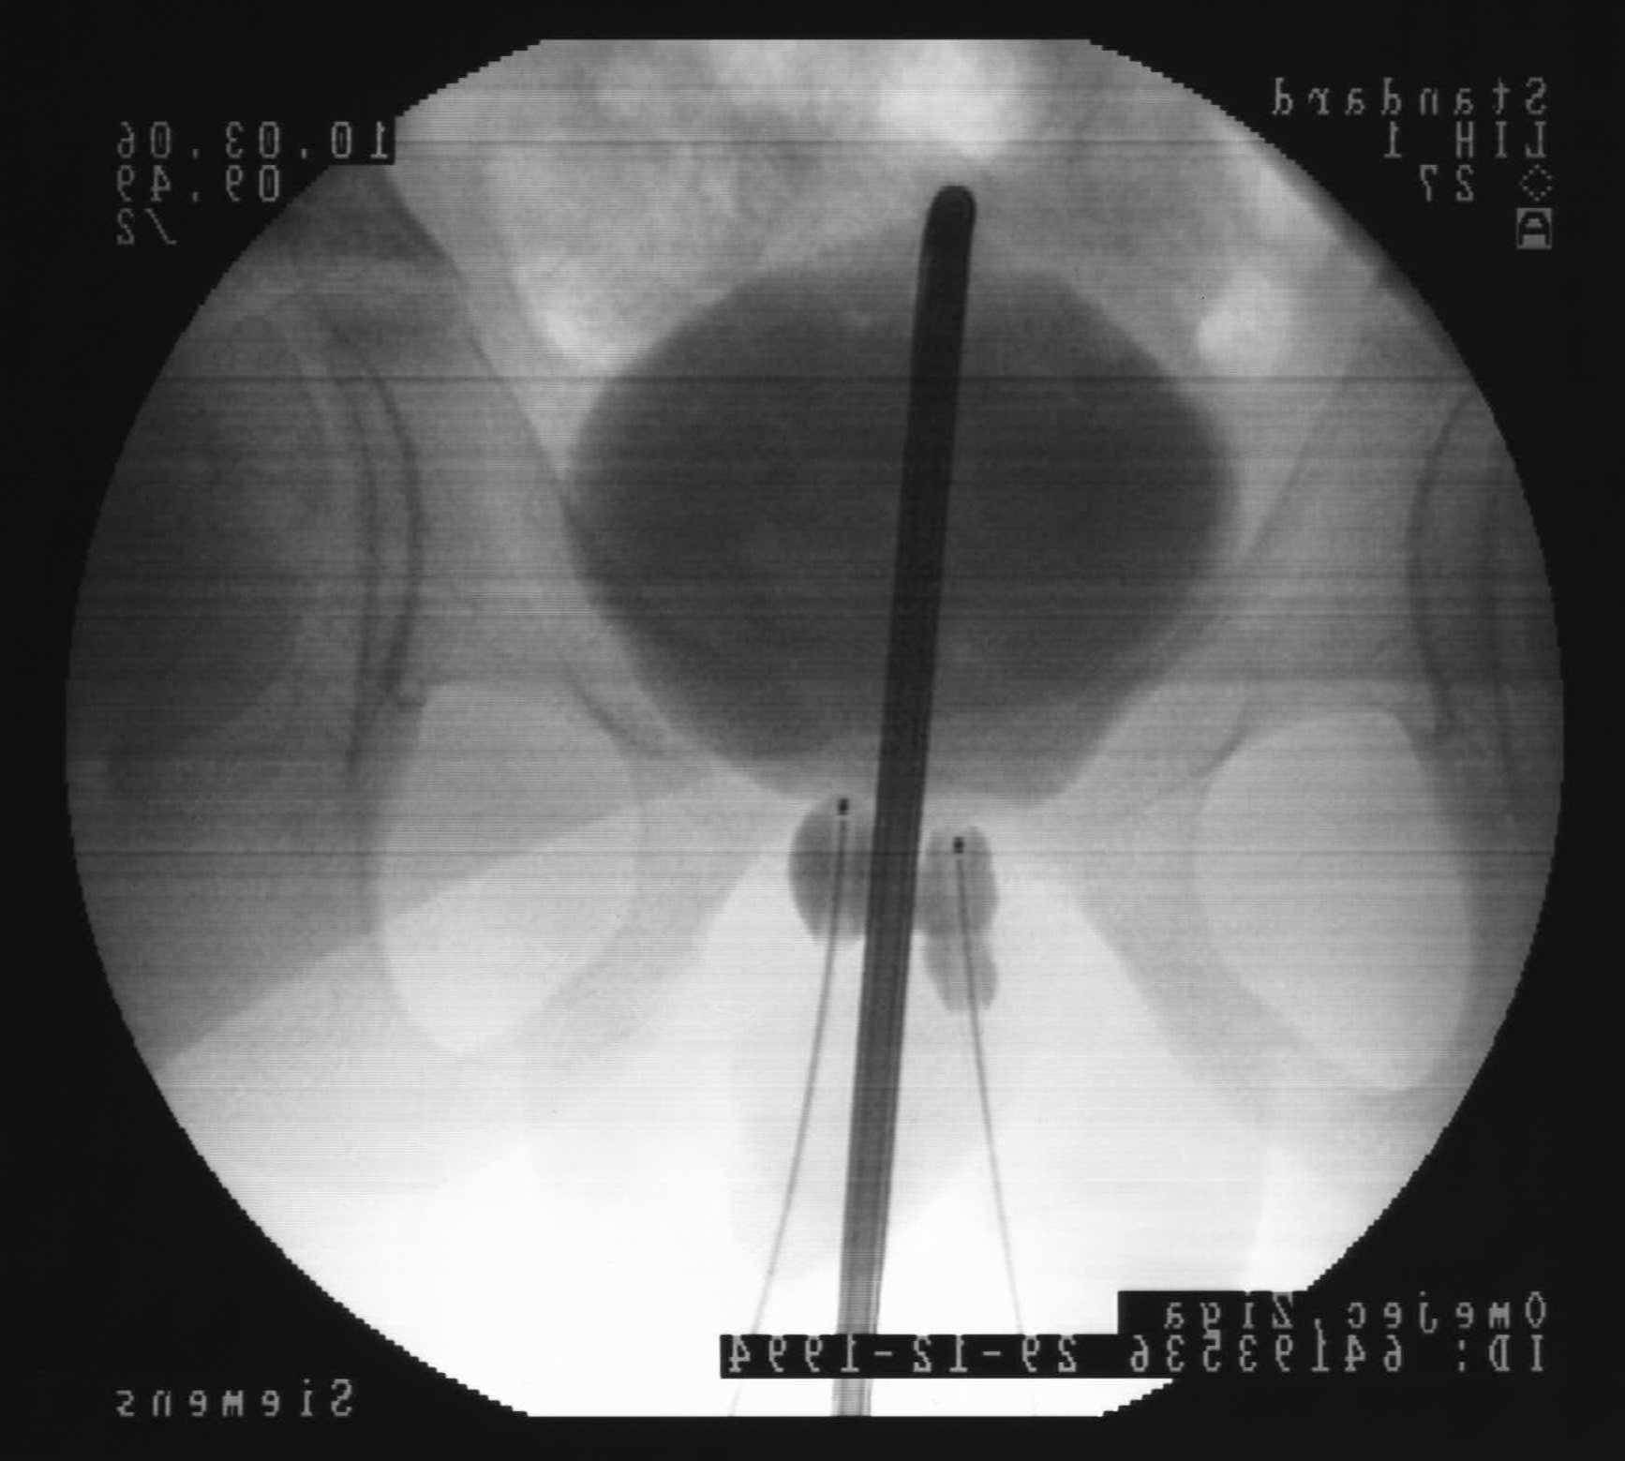
Infection
Erosion
Erosion
Deflation
Migration
Most of complications happen during the first 6 months
Irregular shape of left baloon
Hard tissue for radiation

Slide 23
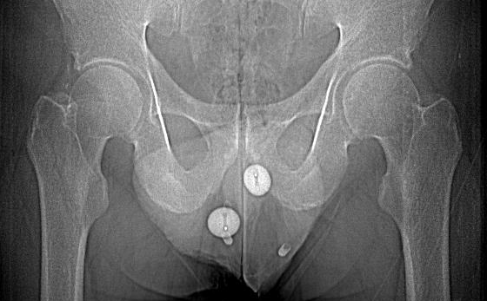
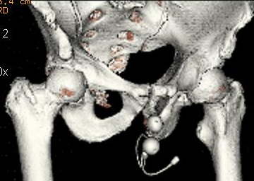
Migration after readjustment (radiation therapy!!)
by Carone R, Giammo’ A et coll

Slide 24
Other sling designs
The REMEEX system is a readjustable suburethral sling; it is composed of a monofilament sling connected via two monofilament traction threads to a suprapubic mechanical regulator
Success rate 65%
(almost all pts with readjustment)
COMPLICATIONS
Bladder perforation 10%
Varitensor infection requiring removal 4%
Urethral erosion 2%

Slide 25
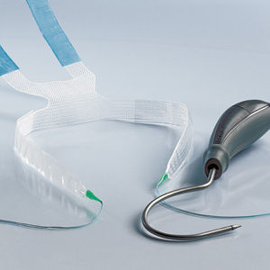
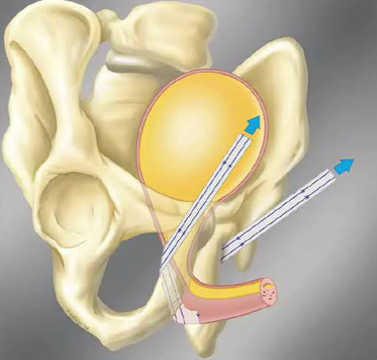
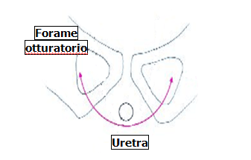
TOT Maschile

Slide 26
TAKE HOME MESSAGE
SFINTERE ARTIFICIALE «GOLD STANDARD» NONOSTANTE 1 SOLO PRODOTTO IN COMMERCIO E NONOSTANTE LE COMPLICANZE
SLING MINIINVASIVI MA COMPRESSIVI SULL’URETRA. RISULTATI A DISTANZA ?
UTILIZZARE SOLO NELLE INCONTINENZA LIEVI O MODERATE

Slide 27

Female stress urinary incontinence:
Treatment
Failure of conservative management strategies e.g.
  lifestyle changes
  Physical therapies
  Scheduled voiding regimes
  Behavioural therapies
  Surgical treatment is the standard approach
Despite hundreds of different surgical procedures
the optimal surgical technique DOES NOT YET EXIST

Slide 28
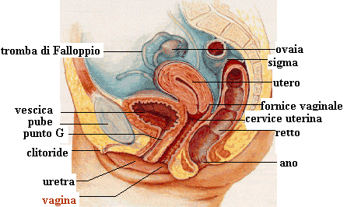
Artificial Urinary Sphyncter ???
Not so easy to implant !!!

Slide 29
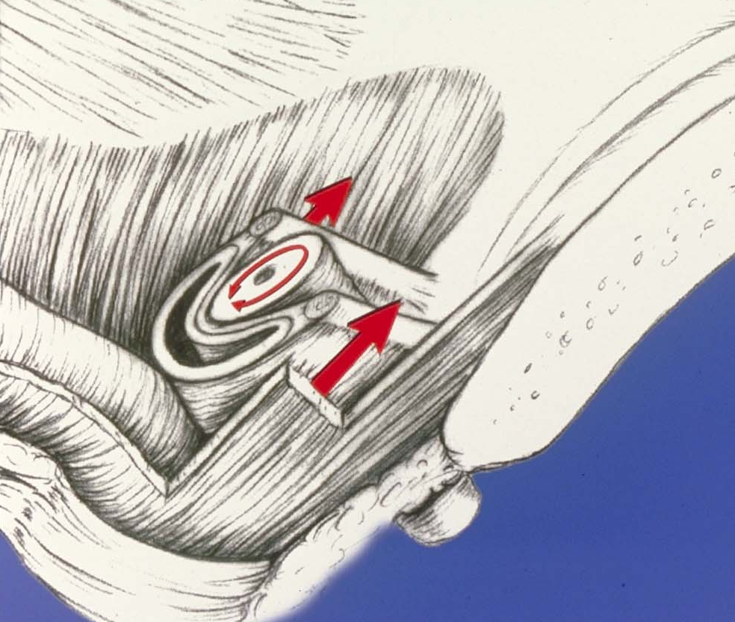
Surgical principles
Pubo-urethral fixation of mid-/distal urethra
Repositioning of bladder neck
Improvement of coaptation of urethral endothelium
Three subsystems:
2. Support: Fascial
Sphincteric System:
  Vesical neck &
  Urethra
3. Support: Levator Muscles

Slide 30
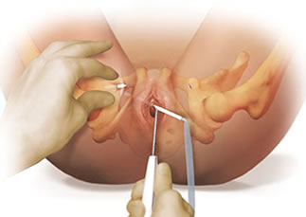
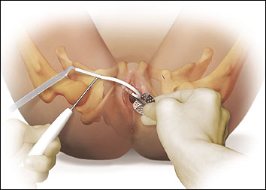
MID-URETHRAL SLING
Tension-free vaginal tape (TVT)
Trans obturator sling (TOT)
The most commonly procedures worldwide:
  easy to perform
  high success rates
  low complication rates

Slide 31
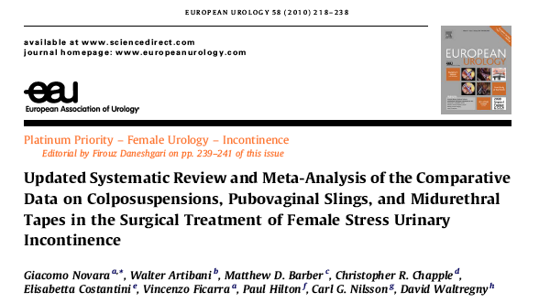
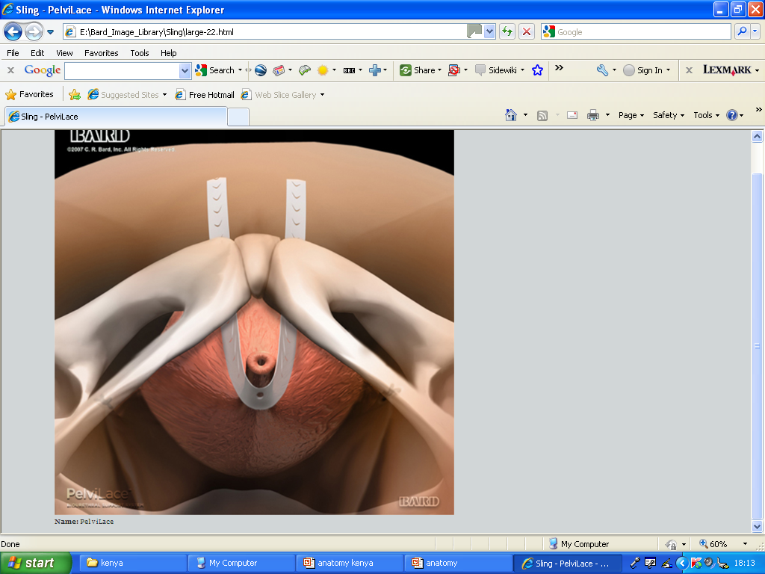
MUS and BURCH:
- Midurethral tapes were associated with significantly higher
overall and objective continence rates than Burch
- Bladder perforations were more common after RT approaches
TVT and pubovaginal slings:
-Similarly effective
- After pubovaginal slings patients were more likely to experience storage LUTS and reoperation
TVT and TOT:
-Objective cure rates were slightly higher with RT than TOT (both in-out and out-in approaches)
- Subjective cure rates were similar

Slide 32
Complications !!
Very few major complications were observed in the RCTs
Intraoperative complications accounted for the majority, with only a few studies providing data on the intermediate- and long- term functional sequelae
Some underreported complications, including storage and voiding LUTS, can be disabling, whereas some intraoperative complications such as bladder injury after TVT have little or no future impact, provided they are promptly recognized and treated
As major complications have a low prevalence in RCTs, reports in prospective surgical series as well as in databases, like the US MAUDE, should be analysed in order to have a fuller picture

Slide 33
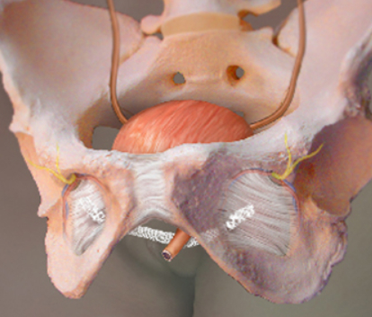
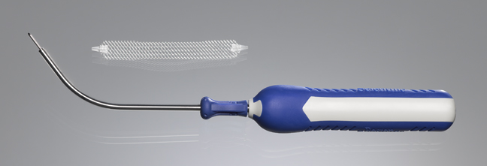
THE EVOLUTION the MINI-SLINGS
Notes:
I think you will all agree that there has been a remarkable evolution over the past decade when it comes to slings for surgery for stress incontinence

Slide 34
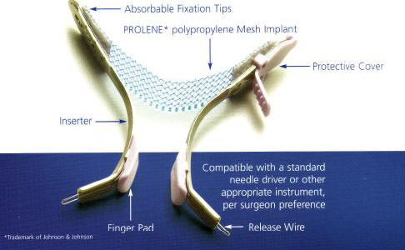
NEW GENERATION SLINGS
Less invasive
Designed for efficacy
Easy to perform
Local anaesthesia is available
  Results are awaited

Slide 35
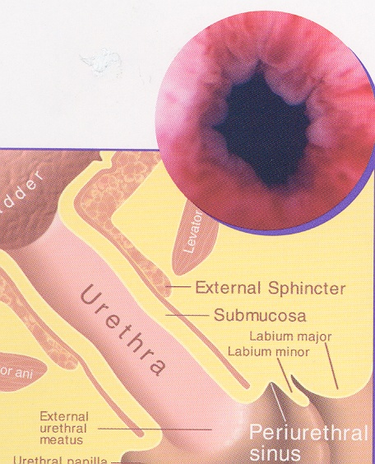
Periurethral bulking
Indications:
Primary
Secondary
Adjuvant
Increased interest results from:
Trend towards minimally invasive techniques
Can be performed as an ambulatory, outpatient procedure
Development of less inflammatory & more durable agents

Slide 36
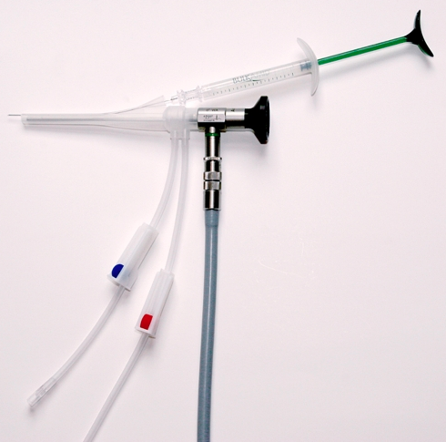
Indications:
Intrinsic sphincter deficiency
Patient choice
Failed previous therapy
High surgical risk
Multiple previous pelvic surgery or radiotherapy

Slide 37
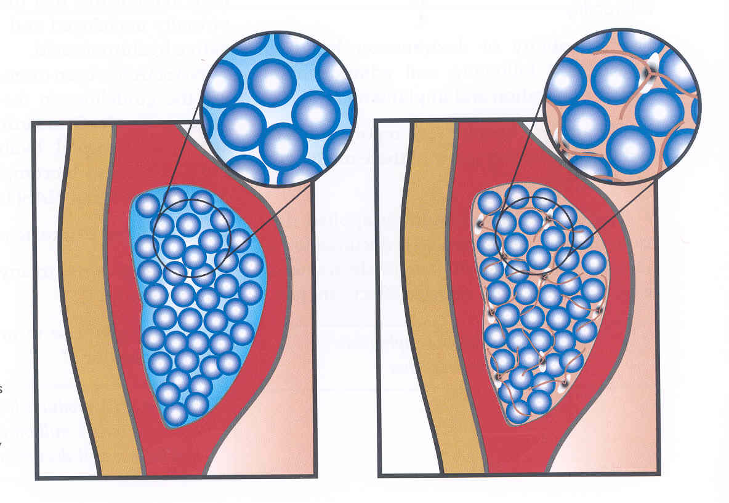
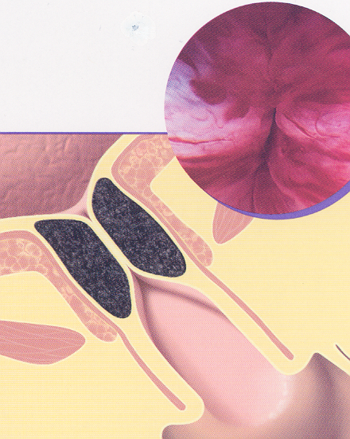
HOW DOES IT WORK?
Augments urethral mucosa – increased functional urethral length^{1,2}
Improves mucosal coaptation
Improves intrinsic sphincter function
Improves pressure transmission – increased urethral closure pressure at proximal urethra³
Promotes urethral obstruction – increased P_{det} max, decreased Q_{max}²
¹Barrenger E et al. J Urol 2000;164:1619-22.
²Monga A K et al. BJU 1995;76:156
³Radley et al. 2000 BJU Int.

Slide 38
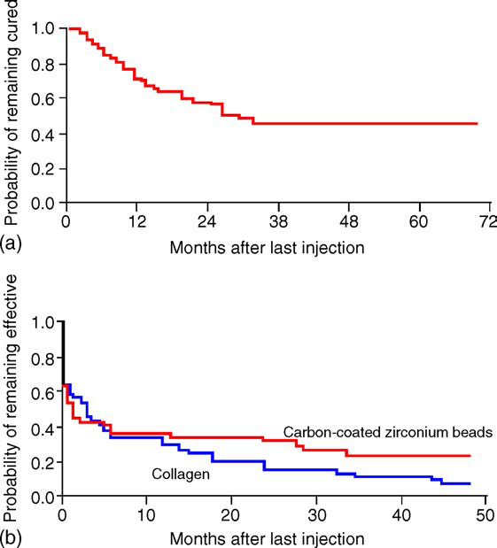
BULKING AGENTS OVER TIME
CONCLUSIONS
50% and 75% cure/improvement rate among all agents at 1 year follow-up, but as low as 19% in the long term
Type of injectable and route of administration do not support preferences (currently insufficient data)
Studies have shown that surgical management is better than urethral bulking

Slide 39
TAKE HOME MESSAGE
Treatment of female SUI is a complex issue and requires:
  Good selection of patients
  Multi-strategy therapeutic approach
  Critical review of results
  Attention to patient’s concept of successful outcome
  More research
  Need for specialised center for training and complicated cases

Slide 40
GRAZIE PER L’ATTENZIONE

